Slide 1

Void Management

Slide 2
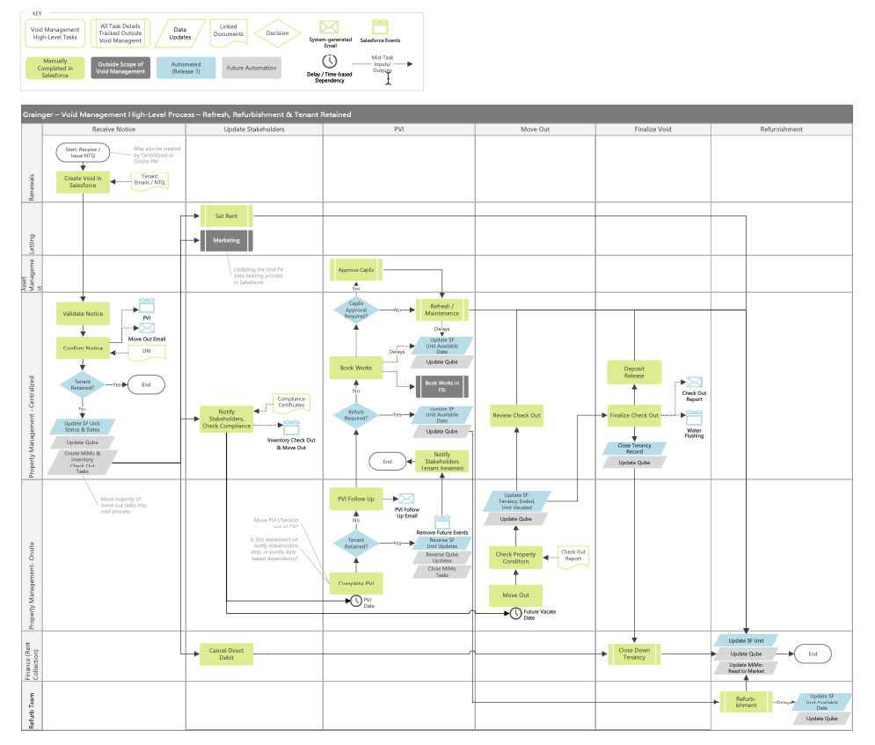
Draft Future State Flow Diagram
Refresh/Refurb/Tenant retained
Updated draft version supplied by Grainger to incorporate detail discussed on calls and focus on dependencies, inputs and outputs for each high-level task

Slide 3
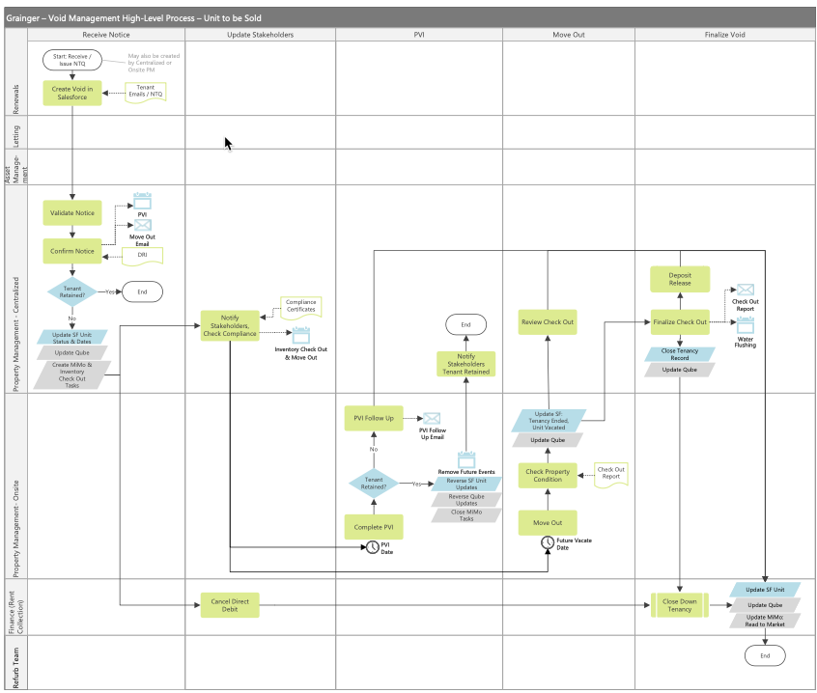
Draft Future State Flow Diagram
Unit to be Sold

Slide 4
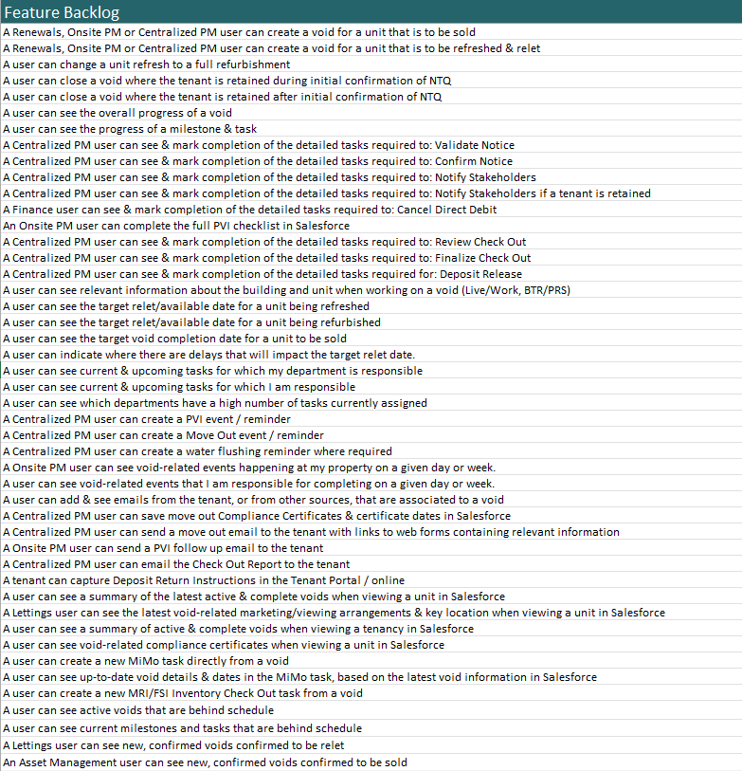
Feature Backlog - WIP
~80 user stories as of 24 April
To be loaded into Grainger JIRA for prioritisation and refinement

Slide 5
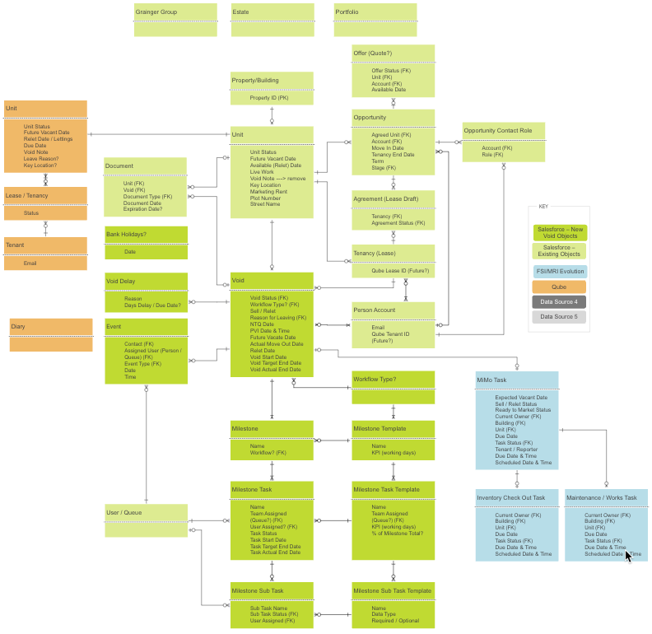
Future State Data Model - WIP
Incorporates hypothesized Void, Milestone + Task object model, to be validated with Grainger

Slide 6
Planned Activities
Activity | Description | Open Box Estimated Hours
Meeting: Qube Demo Date: TBD Duration: 1.5 hours Grainger Team Sam, Nikki | Understand the void-related information in Qube & what should remain vs move to a SF void process. Understand how Qube defines leases with a Salesforce tenancy object in mind. Existing integration capabilities. | 3
Meeting: Document Management Date: TBD Duration: 0.5 hours Grainger Team Sam, Nikki | Review where void-related documents should be saved &, if not in SF, understand existing integration capabilities. | 1
Meeting: Salesforce Property review Date: TBD Duration: 1 hours Grainger Team Sam, Nikki | Deeper dive into the aspects of current functionality (unit data) that overlaps with void process & possible changes required | 2
Complete feature backlog | Capture all user stories in JIRA backlog | 16

Slide 7
Planned Activities
Activity | Description | Open Box Estimated Billable Hours
Finalise future state process flows | Complete future state process flows Review with Grainger team | 8
Create Salesforce High Level Design Document | Technical Architect to create High Level Design Document (HLD) covering proposed solution areas: Integration Data Sharing Document Management Licensing Data Model | 40
Estimated Hours Remaining | 80

Slide 8
Timelines & Deliverables
DELIVERABLES
Budget
Timeline
3 weeks remaining
Feature Backlog in Grainger PLC JIRA instance
High Level Design:
      Integration
      Data Sharing
      Document Management
      Licensing
      Data Model
      Process Flow - Future State
  Project Proposal
    Project Methodology
    Costs & Timelines
Effort | Hours | Cost
Spent | 30 | £4,500
Forecast | 80 | £12,000
Total | 110 | £16,500

Slide 9
Next Steps
Grainger to approve additional hours
Setup "Introduction to Open Box Agile" session with Grainger
Schedule remaining demos and requirement gathering sessions
Review draft process flows with Grainger
Setup weekly PM calls for next 3 weeks

Slide 10
Appendix

Slide 11
Completed Activities
Date | Meeting & Attendees | Key Understandings Gained | Billed Hours
15th November 2022 1 hour | Grainger Salesforce Demo Sam, Jacob | Reviewed current Lead-to-Lease process in Salesforce Renewals are a labour-intensive manual process (±400 in March, ±1500 in September) Business has no visibility into status | 0
31st Jan 1 hour | Review current state Jon, Sam, Lauren, Paul, Brendan | Void process crosses 6/7 teams (±60 users) and 5 different systems Void process needs to be thought of in terms of 2 key journeys: Customer Journey Property Journey The future state should be mapped to 6/7 milestones with multiple parallel tasks within each milestone First release of new void management process should focus on visibility rather than automation End of tenancy (final 2 months) still needs to be mapped Much of the process is not about systems - it is about standardising other elements like contracting partners and rates | 0
3rd Feb 30 mins | Follow Up Jon, Sam, Lauren Costa | No single user/team is currently considered to be the owner of the void process Ideally this should be owned by the PM team | 0

Slide 12
Completed Activities
Date | Meeting & Attendees | Key Understandings Gained | Billed Hours
17th March 1.5 hours | Open Box / Grainger meet the core team Jacob, Jon, Anita, Sam | Anita’s team use Salesforce daily, but do a lot of manual work to update other systems that are not integrated to Salesforce E.g., leases are created manually in Qube – opportunity for integration + automation Anita’s team are looking for improvements to reduce manual work so they’re able to onboard ±1800 new units There is currently no update from Qube -> Salesforce, hence no way to see actual tenancy status in Salesforce (early exits, rolling tenancies etc.) Other opportunities for improvement: Cases for managing complaints Exposing tenant payment status in Salesforce | 0
22nd March 1.5 hours | Review of future state mocked up by Jonathan Jacob, Jon, Anita, Sam, Nikki | Variations possible within the process: Refresh vs refurb Tenant retention & unit sale Task dependencies & parallel flows How the process starts KPI requirements High level requirements around move out email with web forms & ability for tenant to capture deposit return instruction | 3

Slide 13
Completed Activities
Date | Meeting & Attendees | Key Understandings Gained | Billed Hours
3rd April 1. 5 hours | FSI Demo & Grep Overview Jacob, Jon, Anita, Jaic George, Mike Jones, Sam, Nikki | Grep middleware has near real-time capabilities for Salesforce integration FSI integration capabilities & resources are available Qube upgrades are planned (separate project) to automate tenant & lease creation from a Salesforce opportunity Functionality that needs to remain in FSI vs. other move out tasks that are not functioning effectively in FSI Relationship between FSI void-related tasks Emails generated – internal and tenant emails | 3
N/A | Analysis and documentation | Drafting process flow diagrams Creating feature backlog Designing hypothesized future state data model | 24
Total Billable Hours as of 24 April | 30

